Slide 1


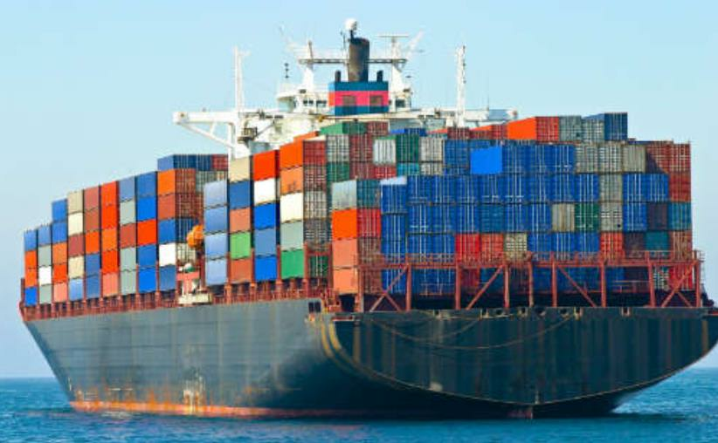
Introduction to Docker

Slide 2

Agenda
-
A Shift from Monolithic to Microservices Architecture
-
Traditional Software Development Workflow(with/without Docker)
-
What is Docker? What problem does it solve for us?
-
Docker Vs Linux Containers
-
Docker Vs Virtual Machine
-
Running Your First Docker Container - Demo
-
Using Docker: Build, Ship and Run Workflow - Demo
-
Building Your Docker Image using Dockerfile - Demo

Slide 3
Agenda
-
Introduction to Docker Swarm
-
How Docker Swarm Mode works?
-
Running Web Application using Docker Swarm Mode - Demo
-
Test Drive Docker & Docker Swarm on Raspberry Pi – Let’s make it happen !
-
How to contribute towards Docker Community?

Slide 4
A Shift from Monolithic to
Microservice Architecture

Slide 5
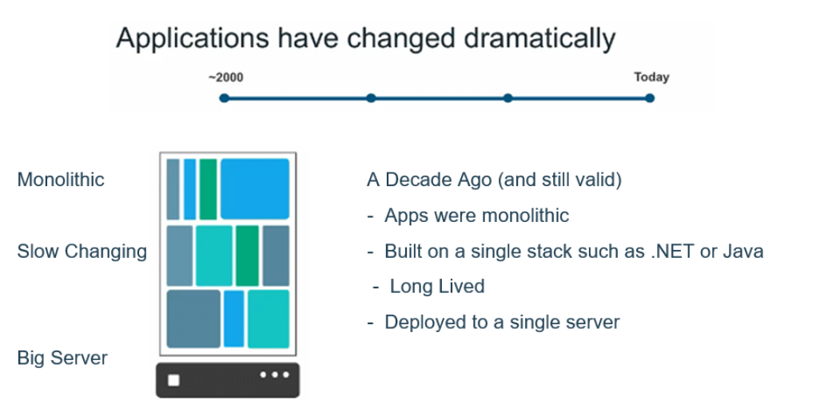

Slide 6
Let’s imagine you are building
a large, complex application,
e.g., Online Store

Slide 7
Successful Software Development
Architecture
Process
Organization

Slide 8
Successful Software Development
Architecture
Process
Organization
Small
Autonomous
team

Slide 9
Successful Software Development
Architecture
Process
Organization
Agile
Small
Continuous Delivery
Autonomous
team

Slide 10
Successful Software Development
Architecture
Monolthic Vs Microservices
Process
Organization
Agile
Small
Continuous Delivery
Autonomous
team

Slide 11
A Close Look at Monolithic
Storefront UI
Browser
HTML
Module
Catalog
Module
Database
Client
App
Reviews
REST/JSON
Module
Orders
Module

Slide 12
Benefits of Monolith
Simple to Develop, Test, Deploy & Scale
-
Simple to develop because of all the tools and IDEs support to that kind
of application by default.
-
Easy to deploy because all components are packed into one bundle.
-
Easy to scale the whole application.

Slide 13
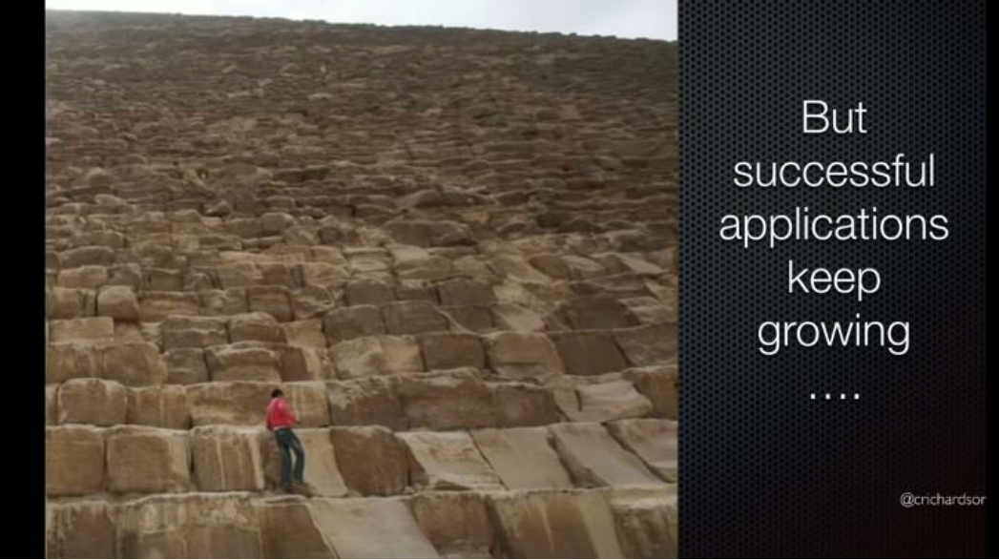

Slide 14
Disadvantages of Monolith
-
Very difficult to maintain
-
One component failure will cause the whole system to fail.
-
Very difficult to understand and create the patches for monolithic applications.
-
Adapting to new technology is very challengeable.
-
Take a long time to startup because all the components need to get started.

Slide 15
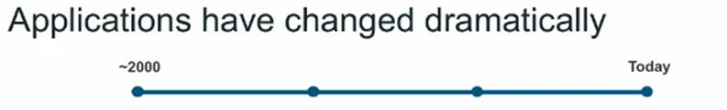





Customer/
Clients/
Users
Data
Today
Storage
- Apps are constantly developed
-
Built from loosely coupled components
- Newer version are deployed often
- Deployed to a multitude of servers
Data
Storage
Data
Storage

Slide 16
Microservice Architecture
Storefront UI
Catalog
Catalog
REST
Service
Database
HTML
Reviews
Reviews
Browser
REST
Service
Database
API
Gateway
Order
Order
REST
Service
Database
Mobile
…
…
Device
Service
Database

Slide 17
Benefits of Microservices
-
Can scale independent microservices separately. No need to scale
the whole the system
-
Can use the latest technologies to develop the microservices.
-
One component failure will not cause entire system downtimes.
-
When developing an overall solution we can parallel the
microservices development task with the small teams. So it helps to
decrease the development time.

Slide 18
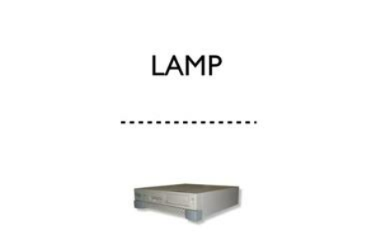
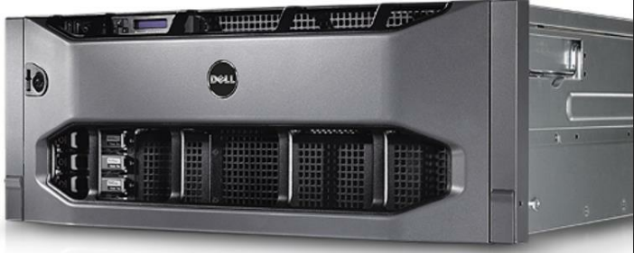
Once upon a time…a Software Stack

Slide 19
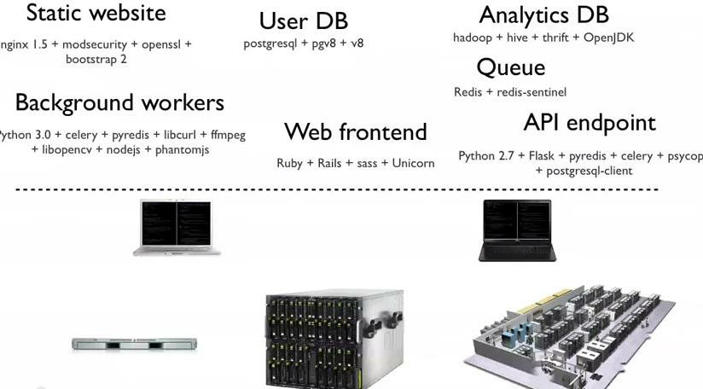
Now much more distributed & complex…

Slide 20
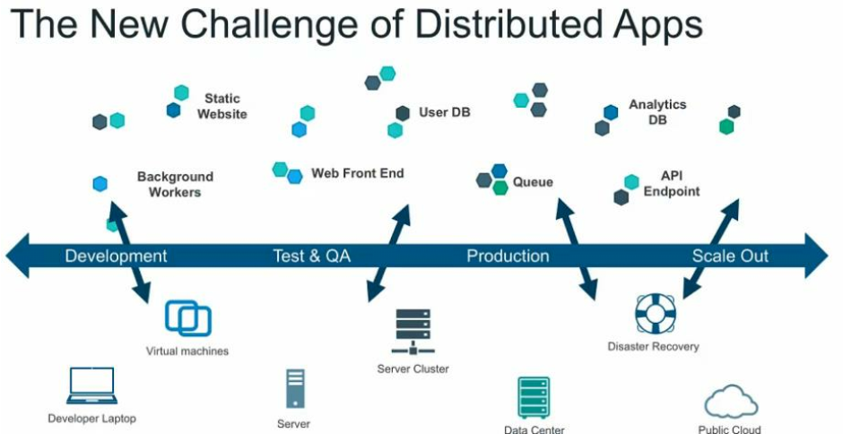

Slide 21
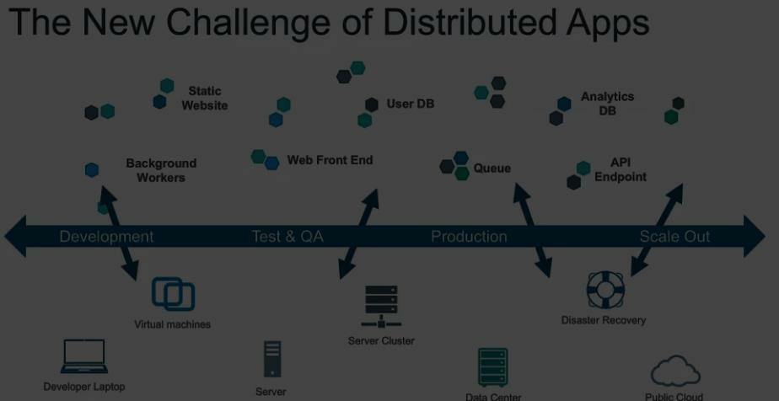


Slide 22
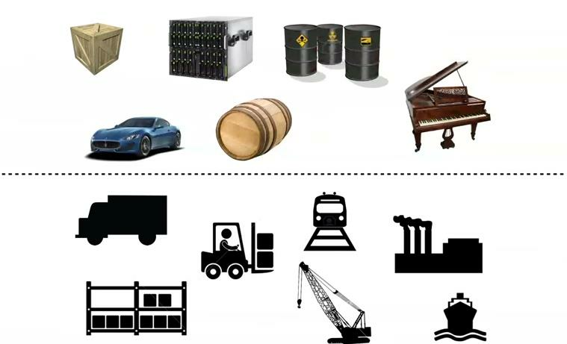
An Effort to solve the problem Complexity

Slide 23
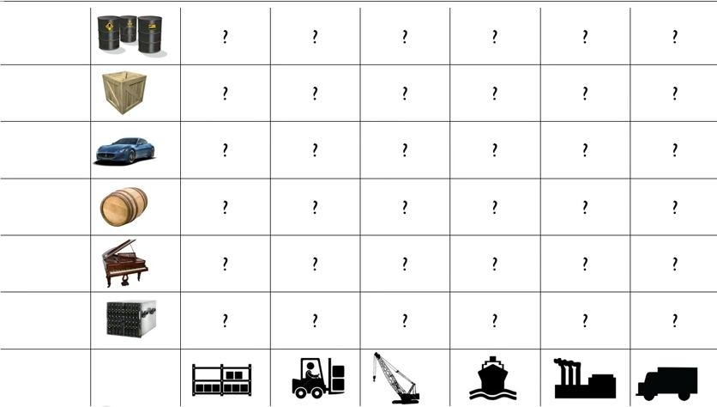
E v e r y p o s s i b l e g o o d t o s h i p X E v e r y P o s s i b l e w a y t o S h i p

Slide 24
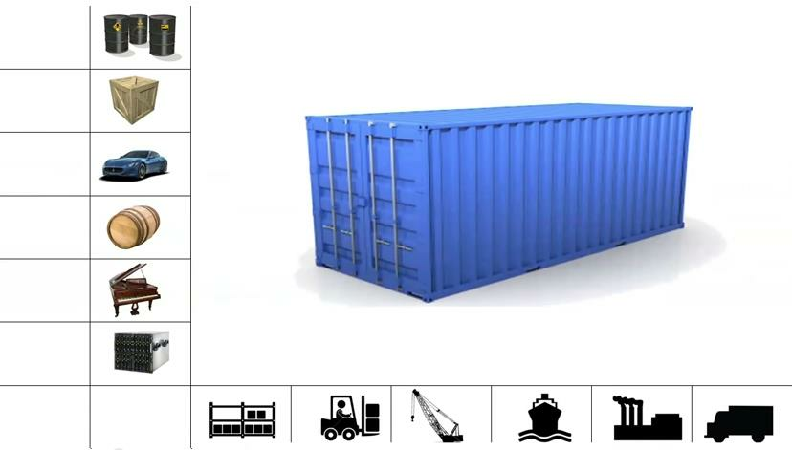
Enter….Internodal Container

Slide 25
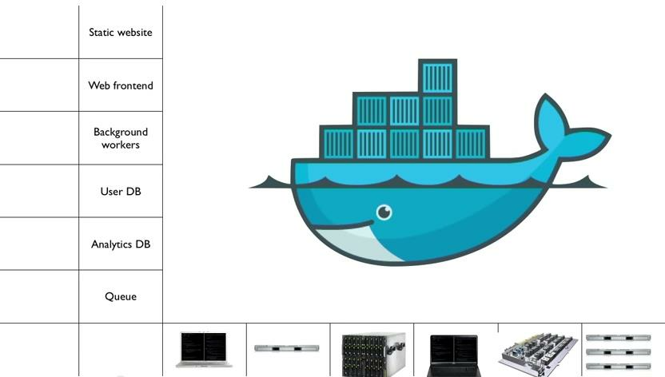
That’s what Docker is all about..

Slide 26
What is Docker and what
problem does it solve?

Slide 27
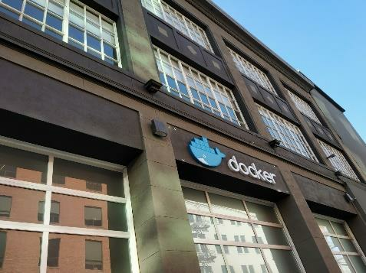
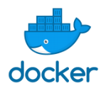
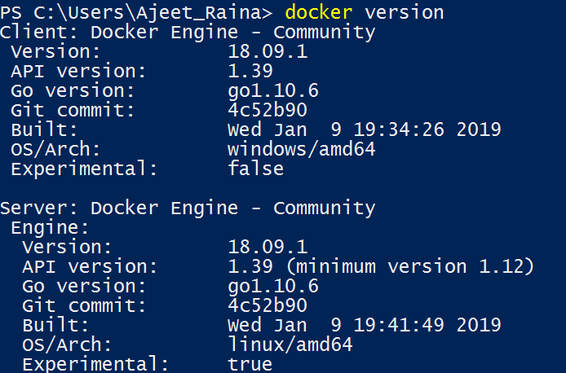
What is Docker?
R e f e r s t o s e v e r a l t h i n g s i n 2 0 1 9
➢Docker as a “Company”
➢Docker as a “Product”
➢Docker as a “Platform”
➢Docker as a “CLI Tool”
➢Docker as a “Computer Program”

Slide 28
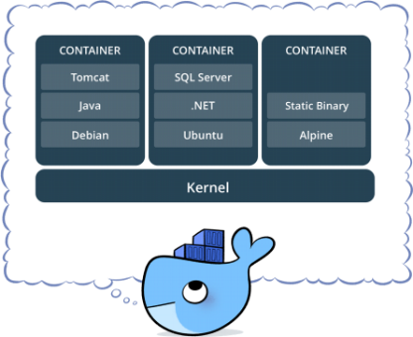
What is Docker?
• Standardized packaging for
software and dependencies
• Isolate apps from each other
• Share the same OS kernel
• Works for all major Linux
distributions
• Containers native to Windows
Server 2016 & 1809

Slide 29
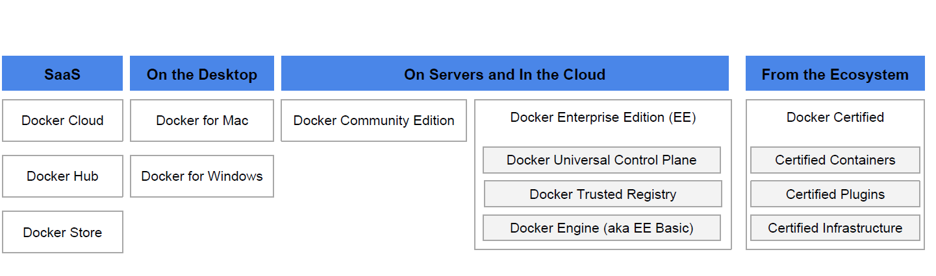

Docker Product Offerings
Recently Docker Sold its Enterprise suite to Mirantis in November2019

Slide 30
History of Docker
➢A Company as well as Product – 6 Years Old company
➢Developed by DotCloud Inc. ( Currently Docker Inc.)
➢A Framework they built their PaaS upon.
➢Released it as open source 3 and 1/2 years back
➢Cross-platform nature and friendliness towards System Admin and Developers
➢Possible to set up in any OS, be it Windows, OSX, Linux, Solaris - It work the same
way
➢Guaranteed to run the same way - Your development desktop, a bare-metal server,
virtual machine, data center, or cloud

Slide 31
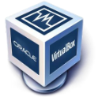
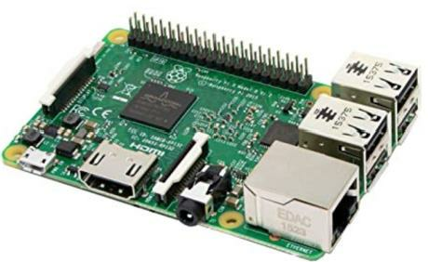
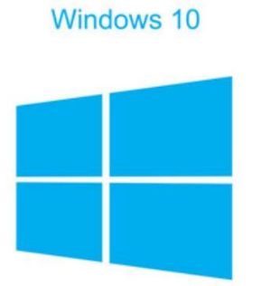


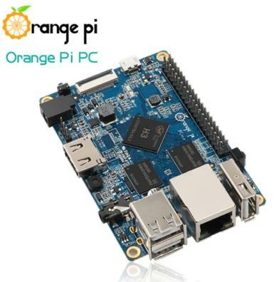
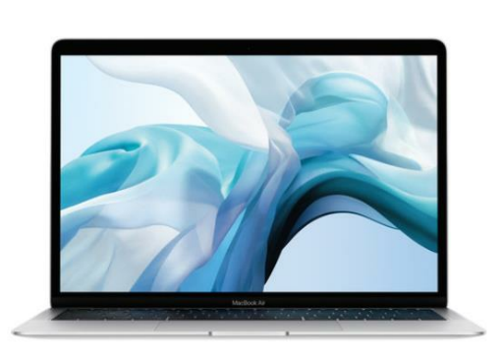
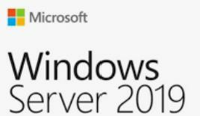



Today Docker runs on

Slide 32
Traditional Software
Development WorkFlow
(without Docker)

Slide 33
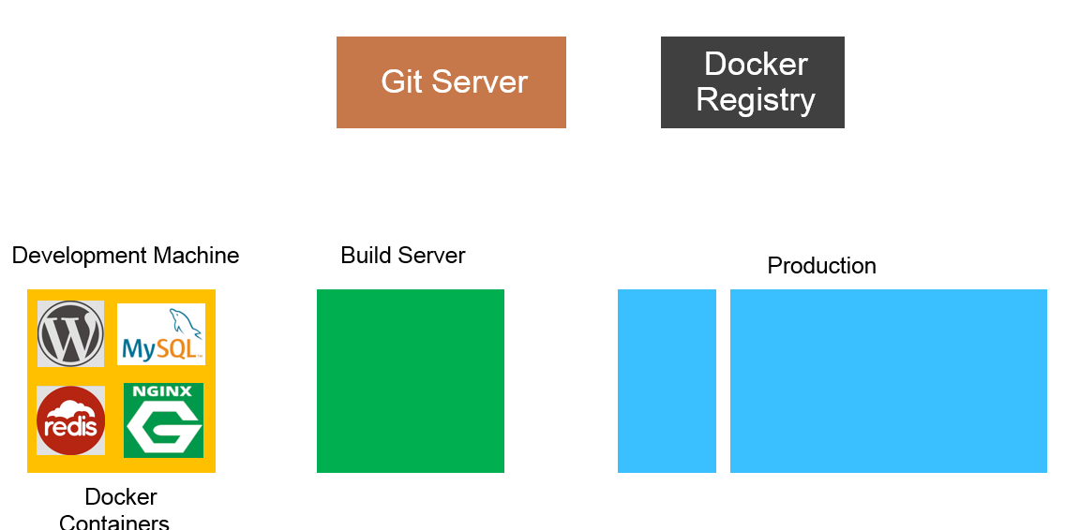



Slide 34
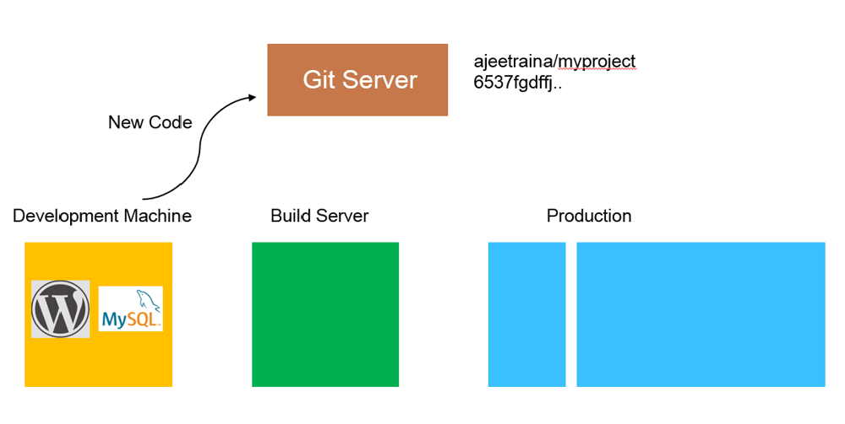

Slide 35
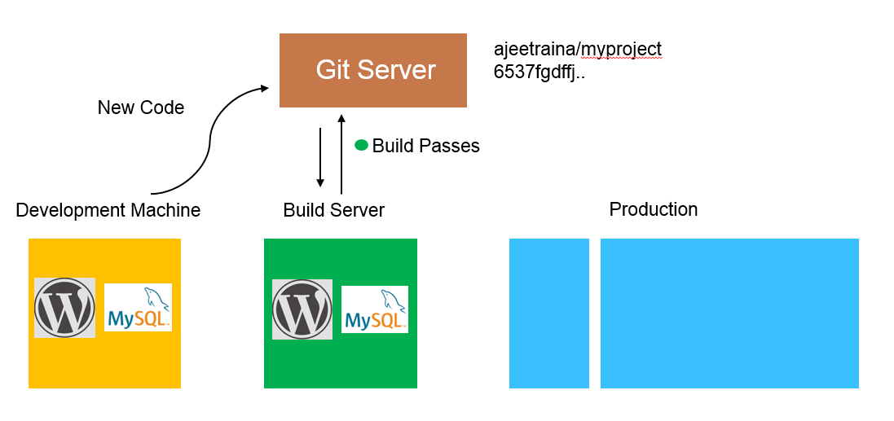

Slide 36
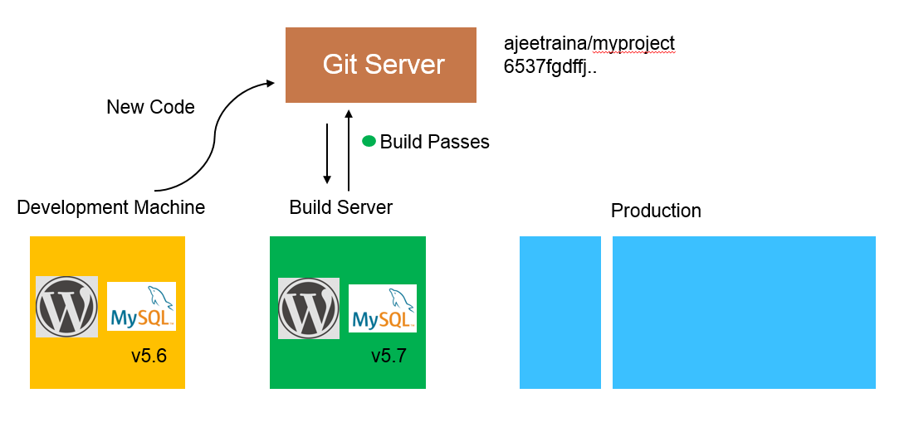

Slide 37
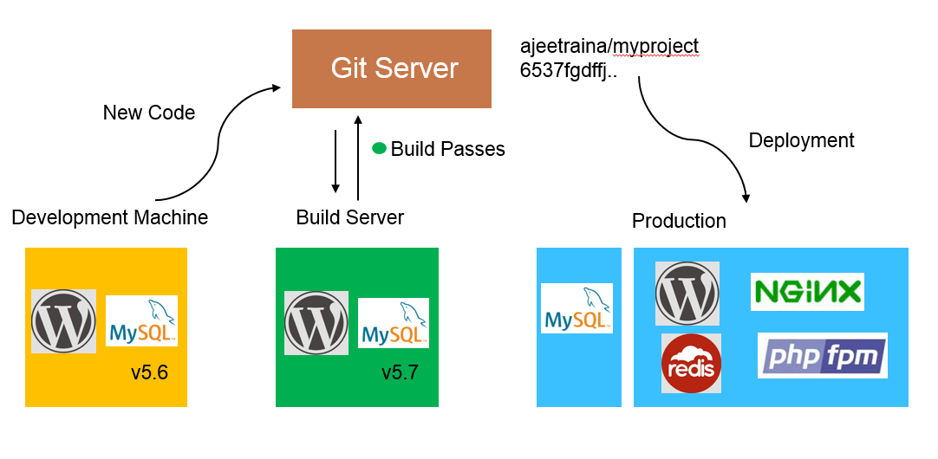

Slide 38
Traditional Software
Development WorkFlow
(with Docker)

Slide 39
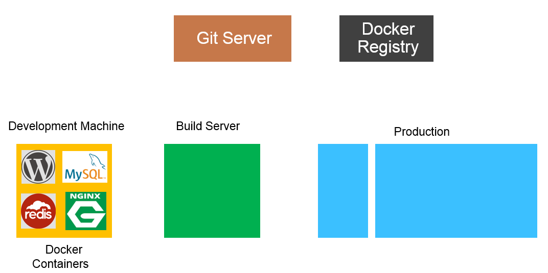

Slide 40
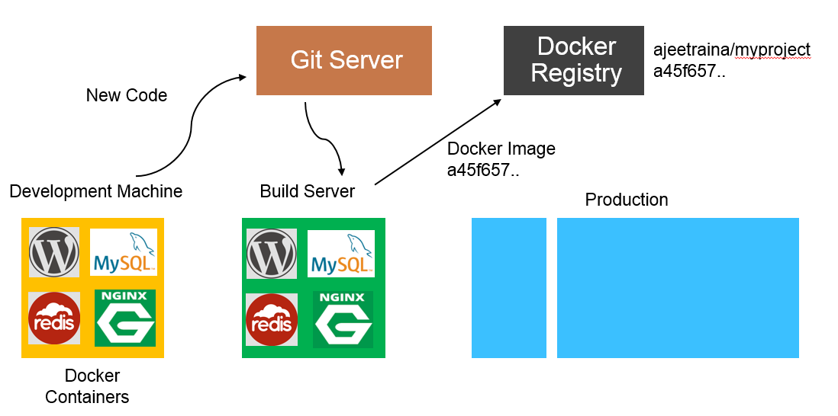

Slide 41
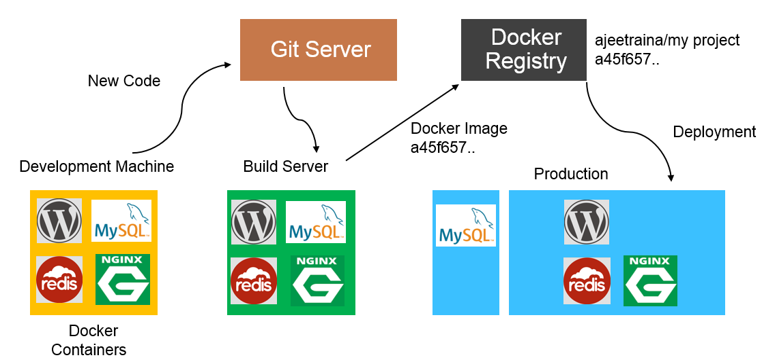

Slide 42
Docker Vs VM

Slide 43
Docker Containers are NOT VMs

Slide 44

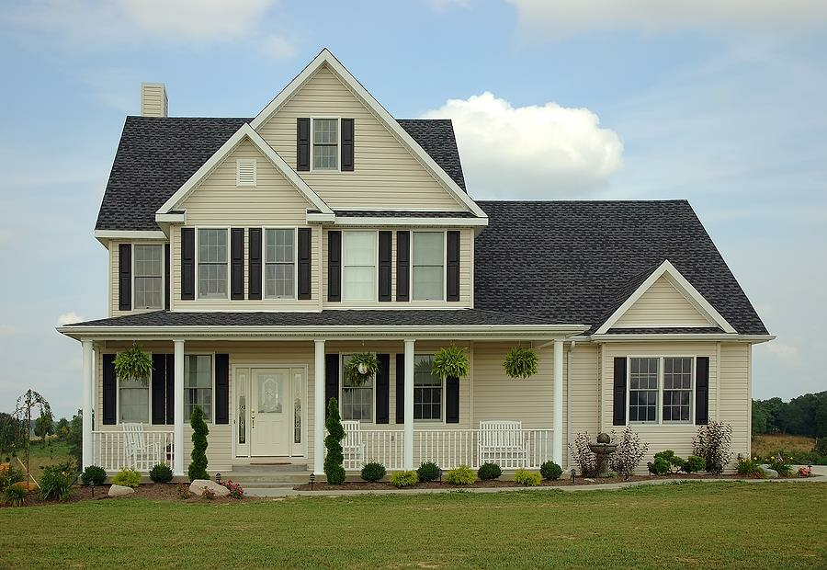
Virtual Machine

Slide 45

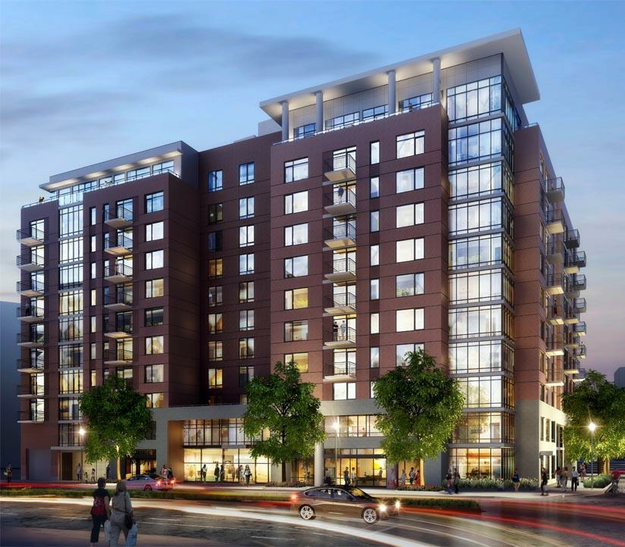
Containers

Slide 46
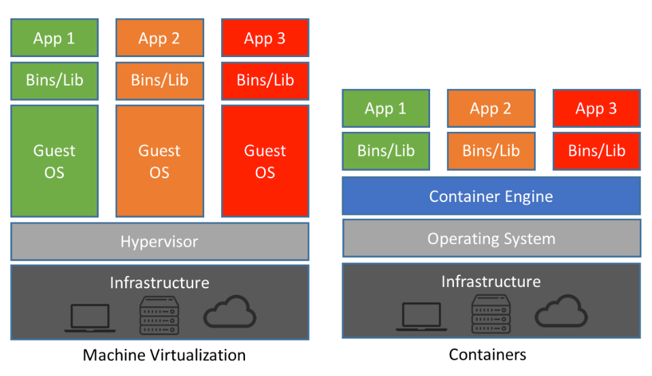
Docker Container Vs VM

Slide 47
Comparing Docker & VM
Virtual Machines
Docker
Each VM runs its own OS
Container is just a user space of OS
Boot up time is in minutes
Containers instantiate in seconds
VMs snapshots are used sparingly
Images are built incrementally on top
of another like layers. Lots of
images/snapshots
Not effective diffs. Not version
Images can be diffed and can be
controlled
version controlled. Docker hub is like
GITHUB
Cannot run more than couple of VMs
Can run many Docker containers in a
on an average laptop
laptop.
Only one VM can be started from one
Multiple Docker containers can be
set of VMX and VMDK files
started from one Docker image

Slide 48
Docker Vocabulary

Slide 49
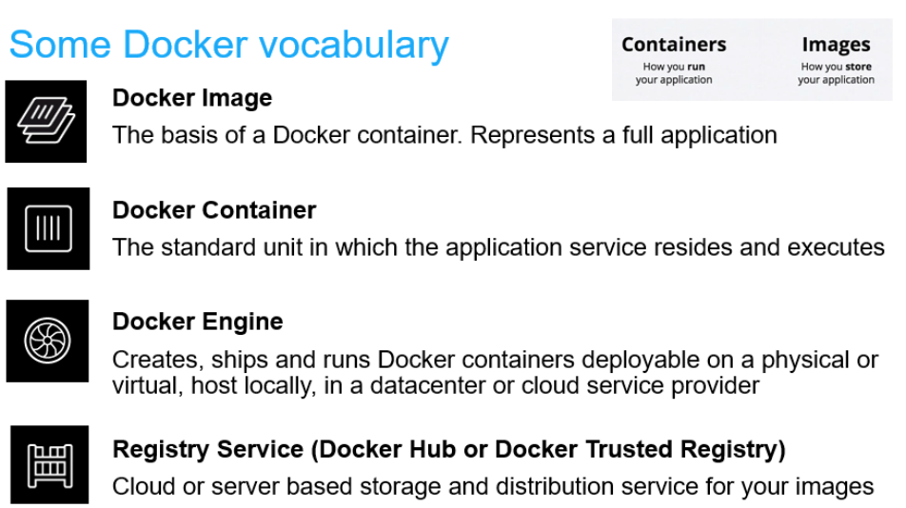

Slide 50
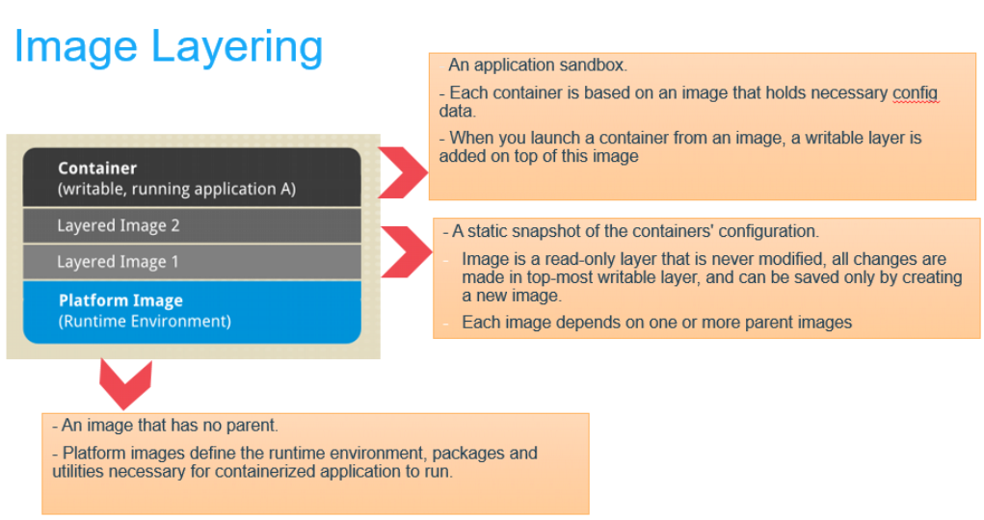

Slide 51
Image Layers
…
Install Requirements
Copy Requirements
Upgrade Pip
Install Python and Pip
Alpine Linux
Kernel

Slide 52
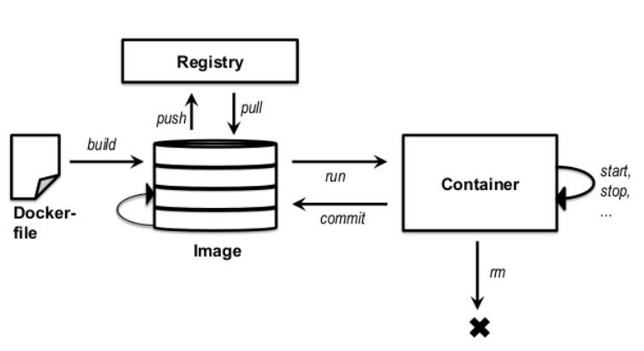
Basic Docker CLIs
Pulling
Docker Image
$ docker pull ajeetraina/hellowhale
Listing out
Docker Images
$ docker image ls
Running Docker Containers
$ docker run –d –p 5000:5000 –-name hellowhale ajeetraina/hellowhale
Stopping the container
$ docker stop hellowhale (or <container id>)

Slide 53
Using Docker – Build,
Ship & Run WorkFlow

Slide 54
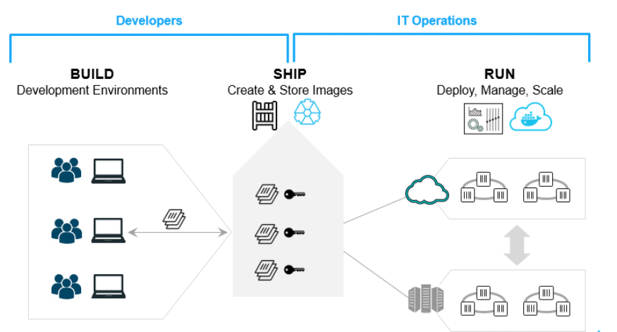
Build. Ship. Run.

Slide 55
Demo
-
Create DockerHub Account(if not completed)
-
Open
https://play-with-docker.com
-
Hello Whale Example
-
Build Your First Docker Image & Push it to DockerHub

Slide 56
Building Docker Containers &
Microservices

Slide 57
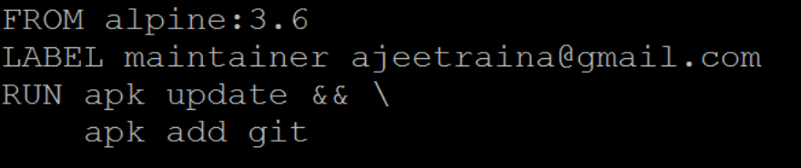
Introducing Dockerfile
Series of instructions to build Docker Images

Slide 58
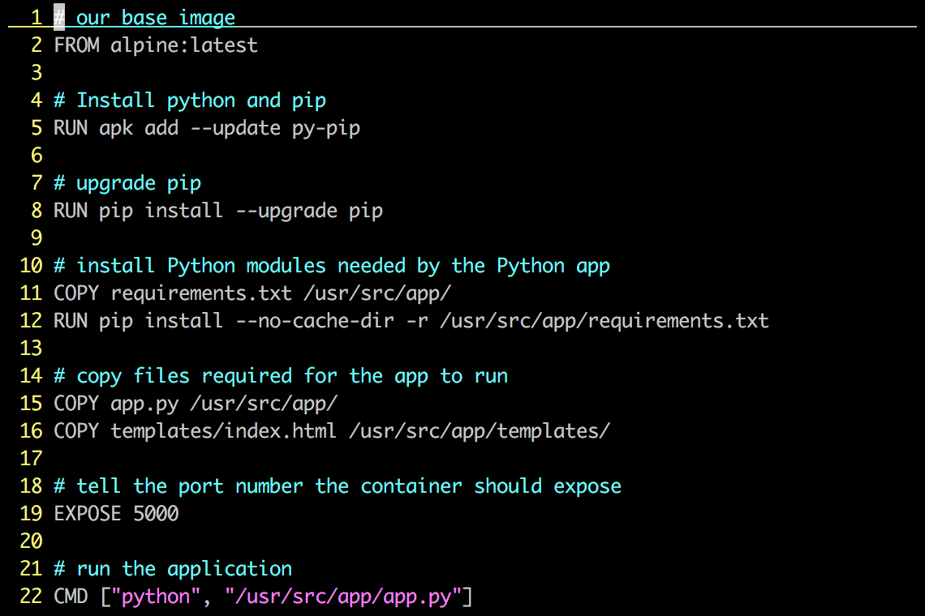
Dockerfile – Example

Slide 59
Each Dockerfile creates a Layer
…
Install Requirements
Copy Requirements
Upgrade Pip
Install Python and Pip
Alpine Linux
Kernel

Slide 60
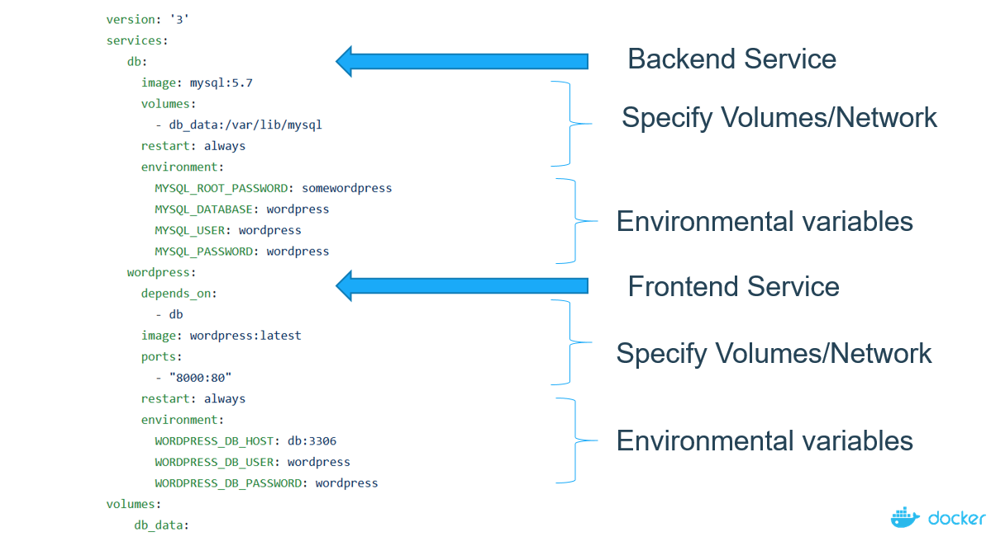
Docker Compose
Compose is a tool for defining and running multi-container Docker applications

Slide 61

Demo
- Running WordPress Application using Docker Compose

